Slide 1
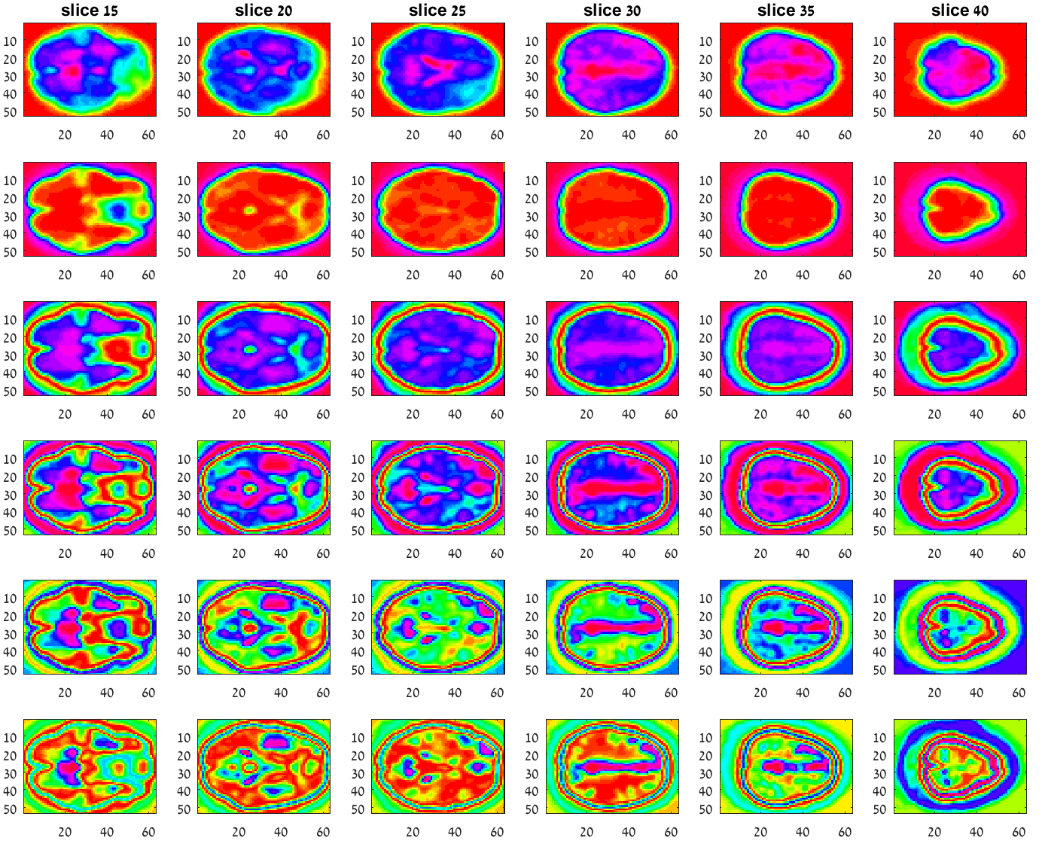
Dimensionality Reduction - Results
Original
Dim #1
Dim #2
Typical Group
Dim #3
Dim #4
Dim #5
Motivation & Agenda
Functional MRI
Current Analysis
Dimensionality Reduction
Clustering
Group Analysis

Slide 2
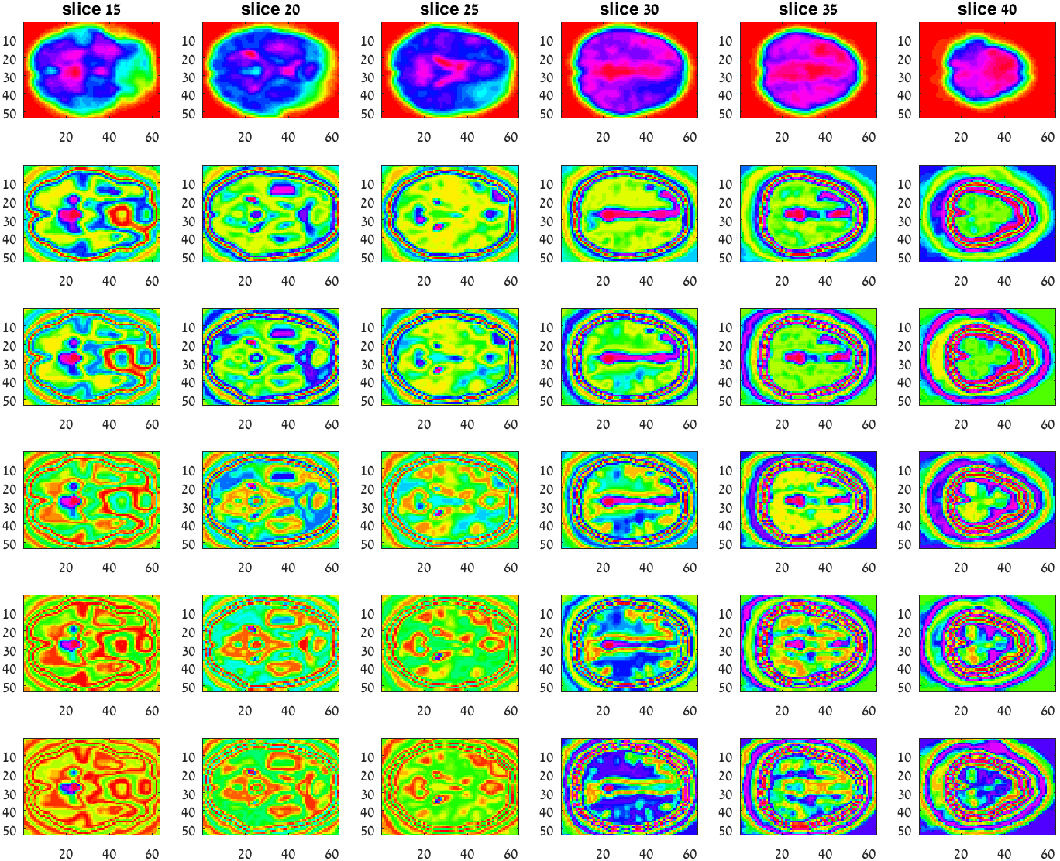
Dimensionality Reduction - Results
Original
Dim #1
Dim #2
Typical Group
Dim #3
Dim #4
Dim #5
Motivation & Agenda
Functional MRI
Current Analysis
Dimensionality Reduction
Clustering
Group Analysis

Slide 3
Group Analysis
Temporal Concatenation
180
180
180
180
46
63
X 180
reshape
Dimensionality
Reduction using
Laplacian
53
Temporal concat. 19 studies
……
~150K
fMRI data
180x19
Motivation & Agenda
Functional MRI
Current Analysis
Dimensionality Reduction
Clustering
Group Analysis

Slide 4
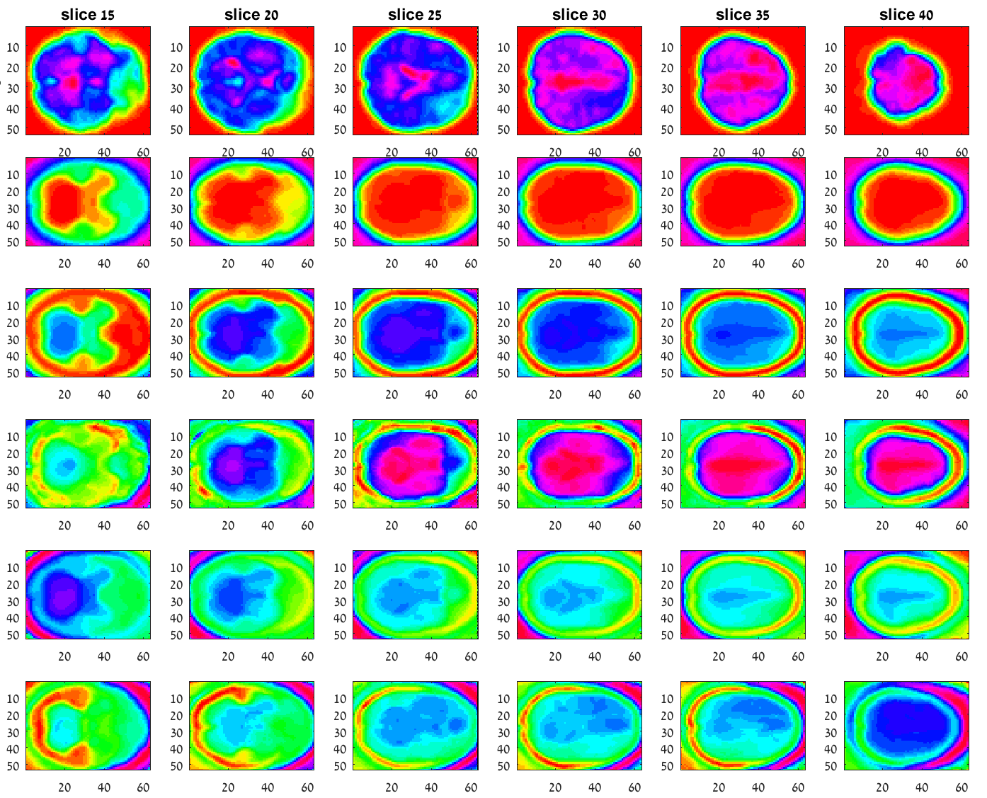
Temporal Concatenation - Results
Original
Dim #1
Dim #2
Typical Group
Dim #3
Dim #4
Dim #5
Motivation & Agenda
Functional MRI
Current Analysis
Dimensionality Reduction
Clustering
Group Analysis

Slide 5
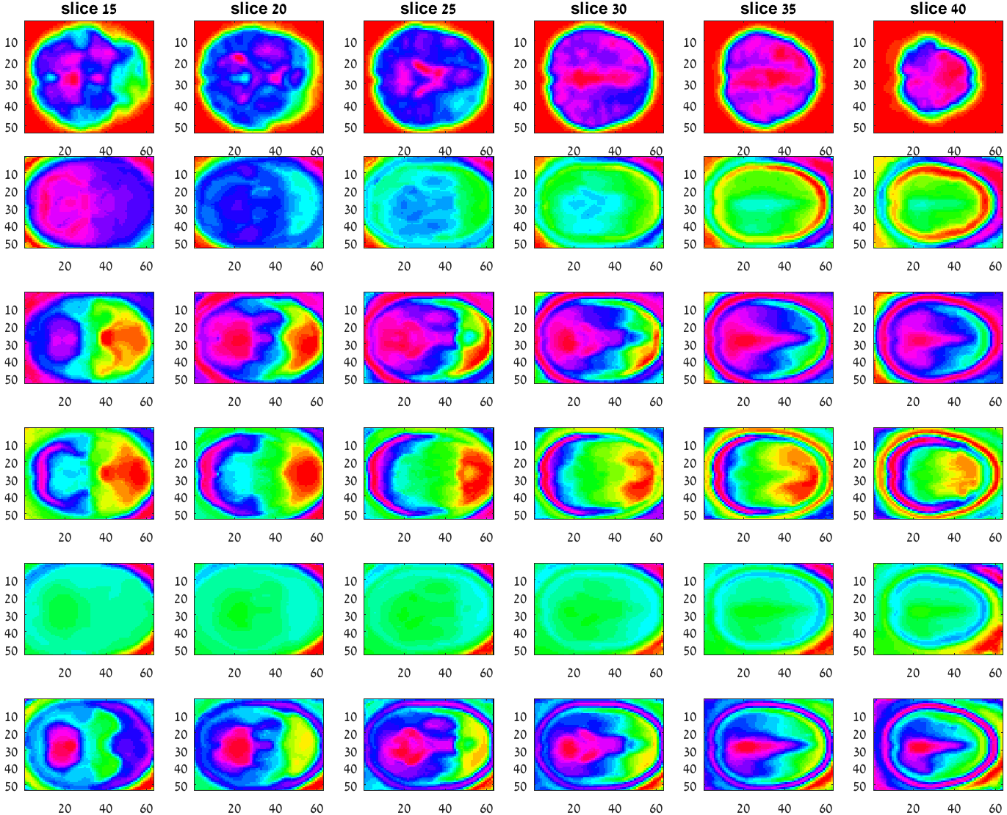
Temporal Concatenation - Results
Original
Dim #6
Dim #7
Typical Group
Dim #8
Dim #9
Dim #10
Motivation & Agenda
Functional MRI
Current Analysis
Dimensionality Reduction
Clustering
Group Analysis

